Slide 1
Parkinson’s Disease Exploratory Data Analysis
Aziza K. Shukurova, 2020147599, Computer Science

Slide 2
Used Datasets
train_peptides.csv – patients’ data on the peptide level:
visit_id – visiting ID.
visit_month – visiting month from the first visit.
patient_id – patient ID.
UniProt - protein ID.
Peptide - sequence of amino acids in peptide.
PeptideAbundance - frequency of the amino acid.
train_proteins.csv – protein expression frequencies from the peptide level data:
visit_id, visit_month, patient_id, UniProt.
NPX - Normalized Protein eXpression (frequency of the protein's occurrence).
train_clinical_data.csv – general data on disease progression:
visit_id, visit_month, patient_id. o updrs_ [1-4] - Unified Parkinson's Disease Rating Scale Scores.
upd23b_clinical_state_on_medication - whether the patient was taking medication during the UPDRS assessment.

Slide 3
Visiting Data

Slide 4
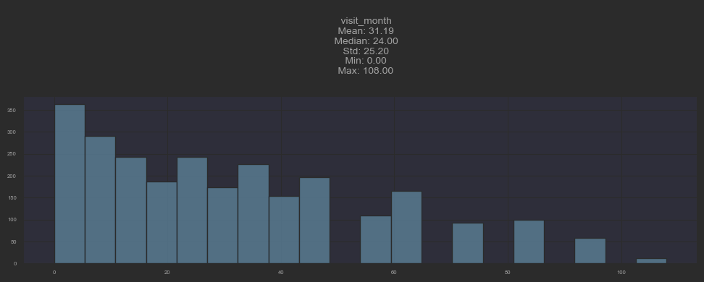
Notes:
most of the patients were visiting tratment facility for less than 40 months. This should not be attributed to a death of the patient in the process since, on average, patients live for 16 years on average after the diagnosis

Slide 5
MDS-UPDRS Data

Slide 6
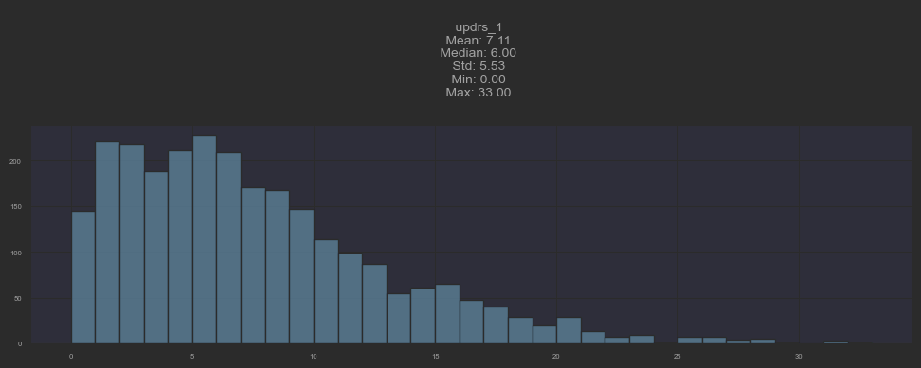
Part I: Nonmotor experiences of daily living

Slide 7
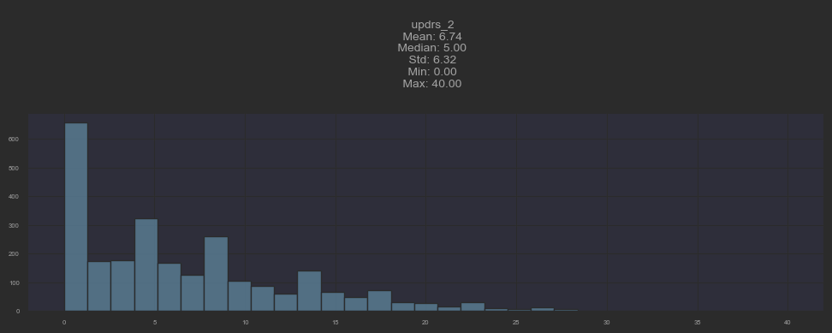
Part II: Motor Aspects of Experiences of Daily Living

Slide 8
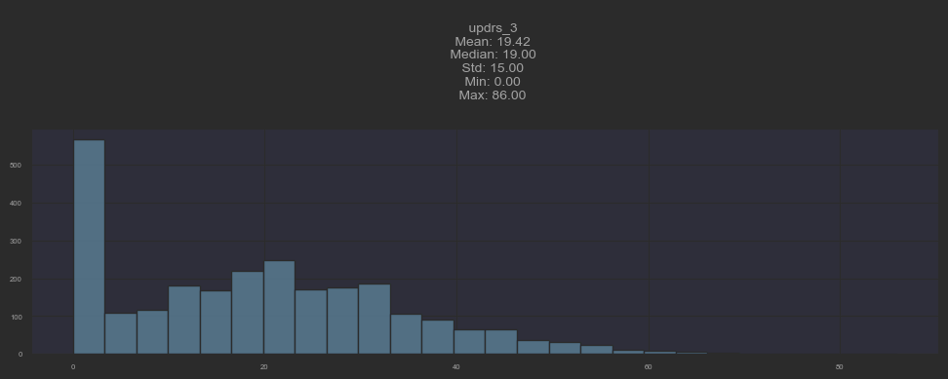
Part III: Motor Examination
Notes:
the same results for part 3: Motor examination: speech, facial expression, rigidity, finger tapping, hand movement,pronation-supination movements of hands
toe tapping, leg agility, etc.

Slide 9
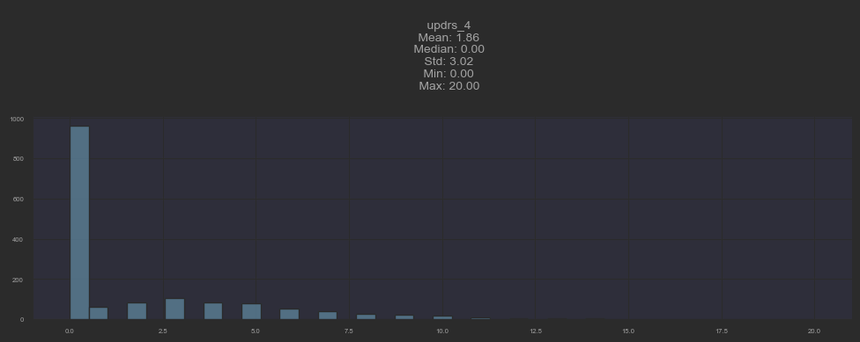
Part IV: Motor Complications
Notes:
The overwhelming majority of patients showed no motor complications, such as dyskineisas (inviluntery movements), motor vfluctuations, dystonia (Unintentional sustained muscle contractions leading to abnormal postures.)

Slide 10
Total MDS-UPDRS Distribution

Slide 11
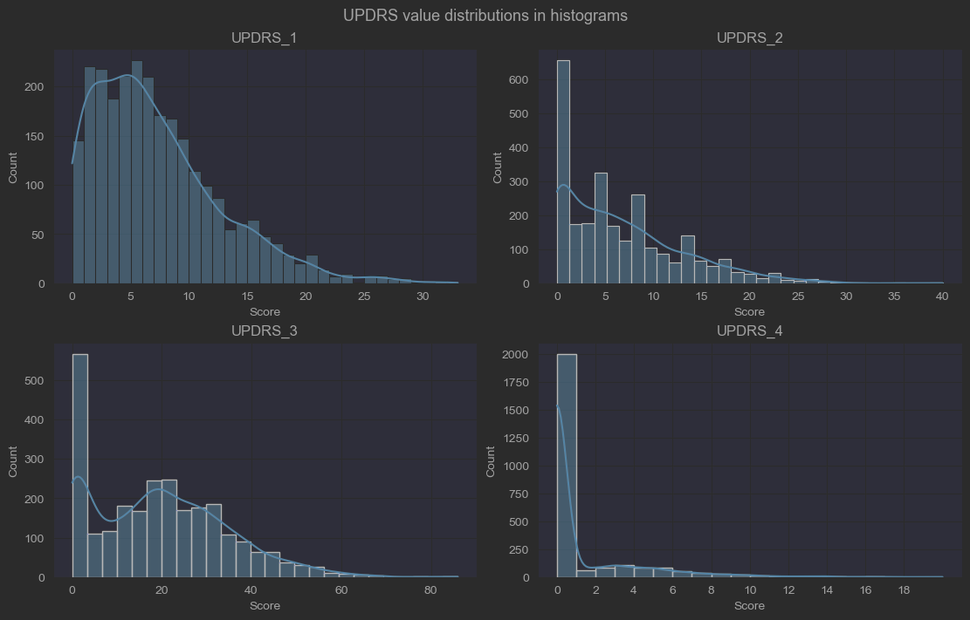

Slide 12
Medication Data

Slide 13
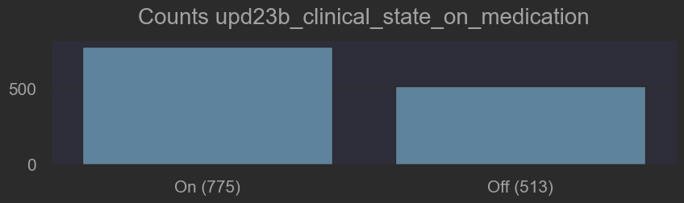

Slide 14
Correlation Among PDS

Slide 15
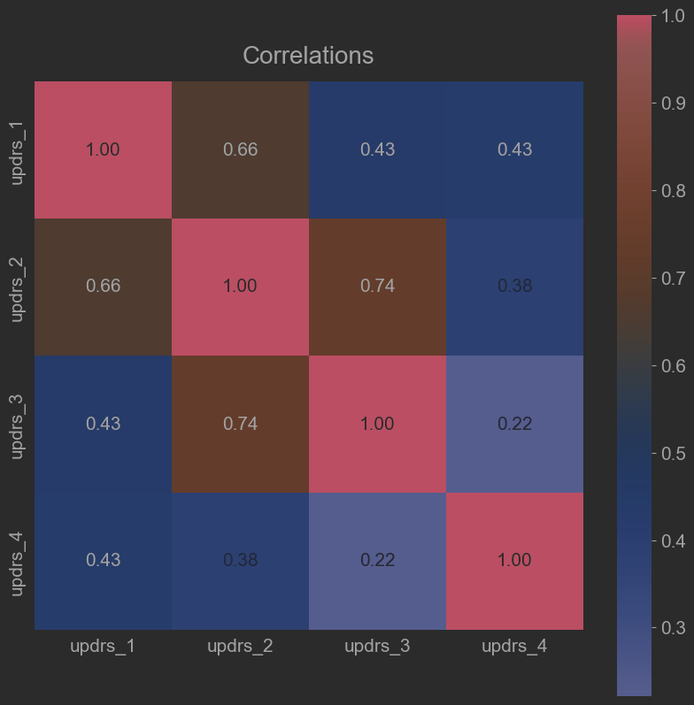

Slide 16
Total Correlation among proteins and
PDS

Slide 17
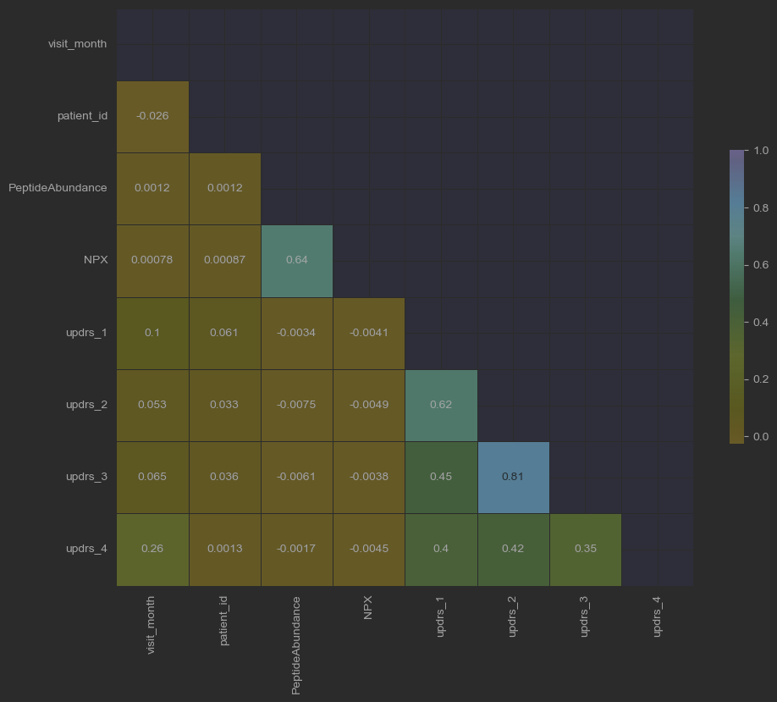

Slide 18
Distribution of patients off and on medication

Slide 19
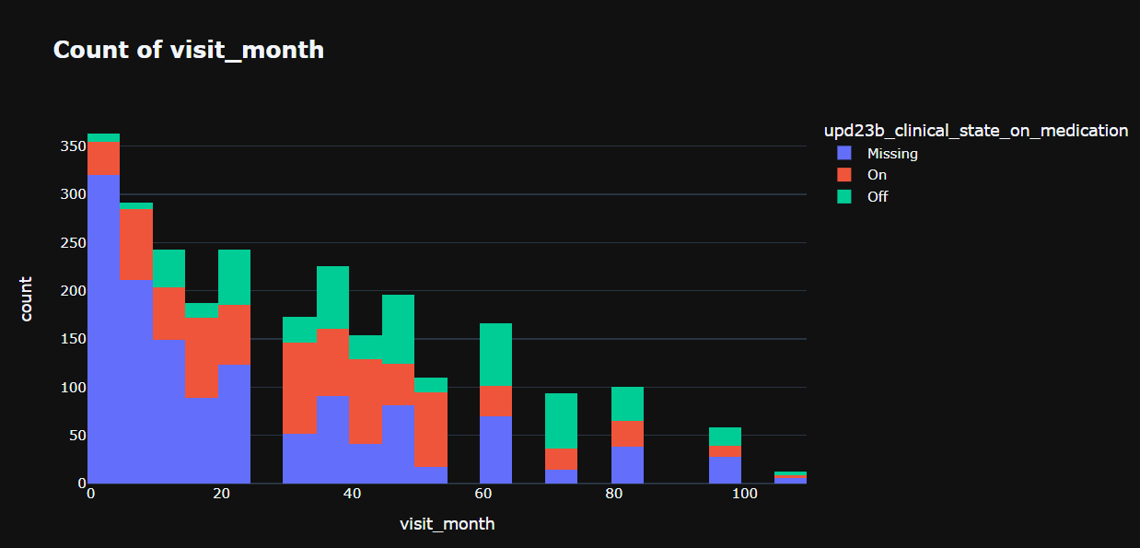

Slide 20
Distribution of patients showcasing a particular PDS, medication and visiting data

Slide 21
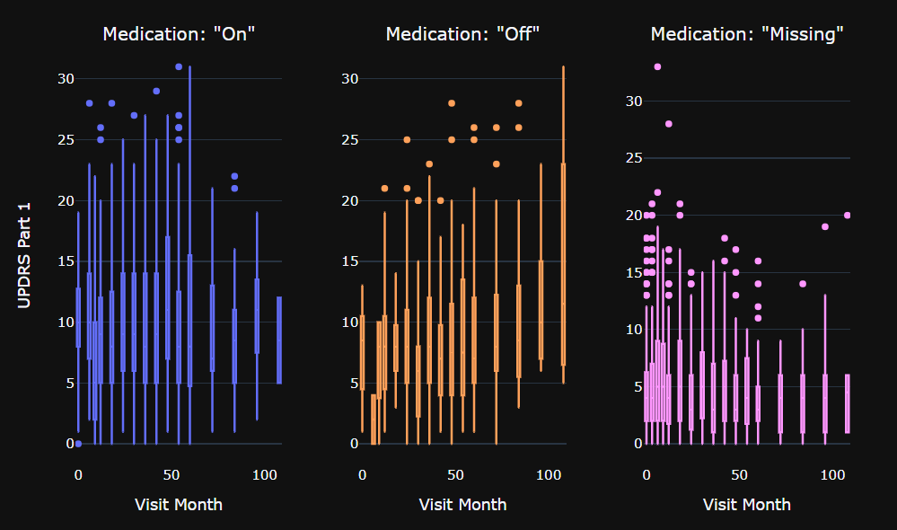

Slide 22
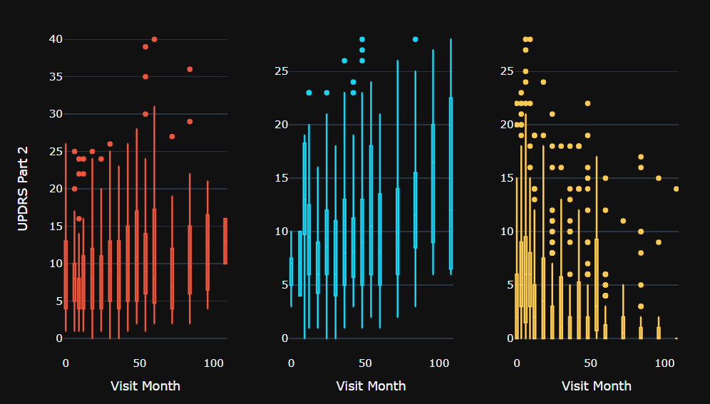

Slide 23
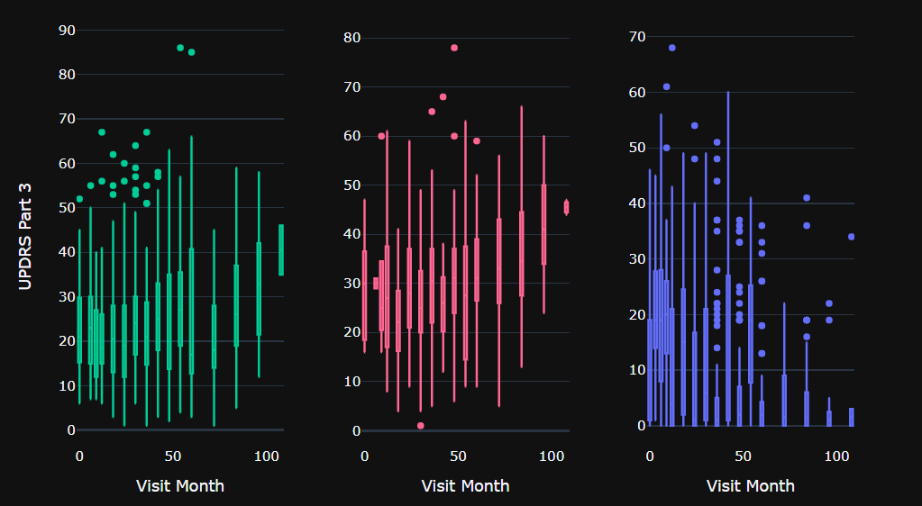

Slide 24
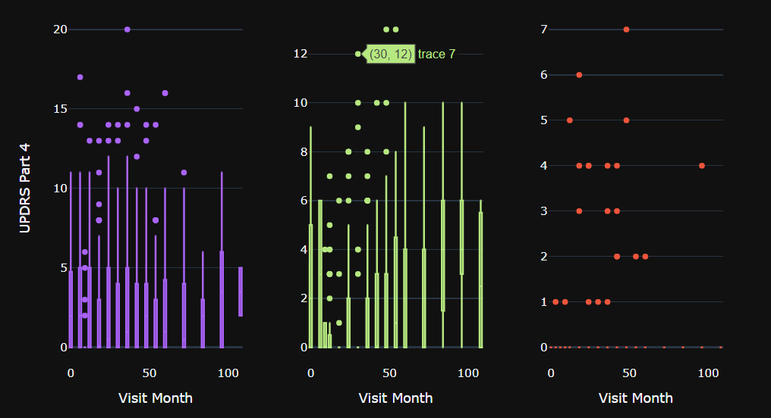

Slide 25
Total Protein Distribution

Slide 26
